Slide 1
Practice on Essential Enterprise Architecture Tool
001
Opening and Introduction

Slide 2
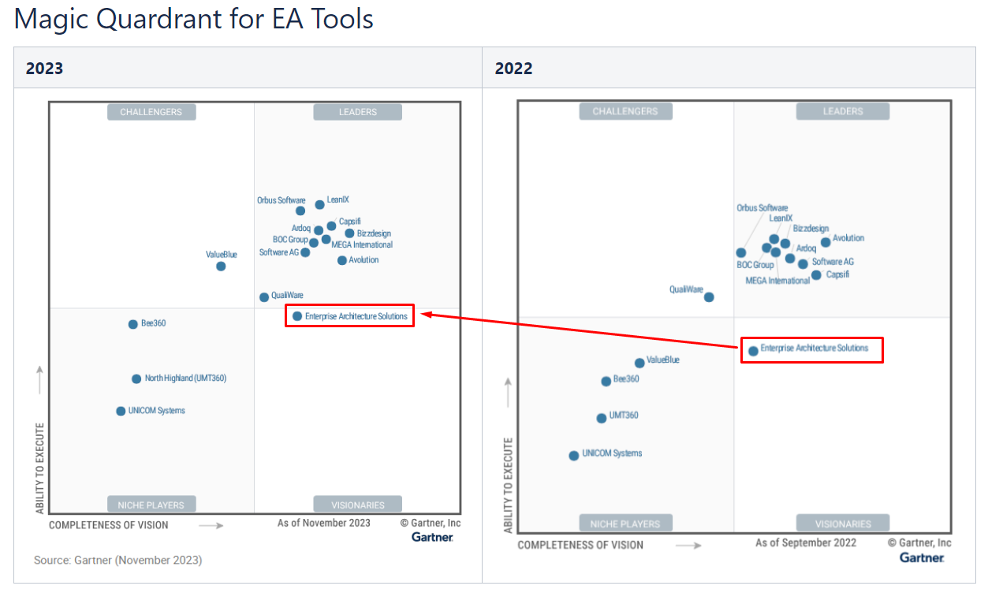
Positioning of Essential

Slide 3

Essential Open-Source Packages Download and Installation
002
https://enterprise-architecture.org/products/essential-open-source/essential-os-download/

Slide 4
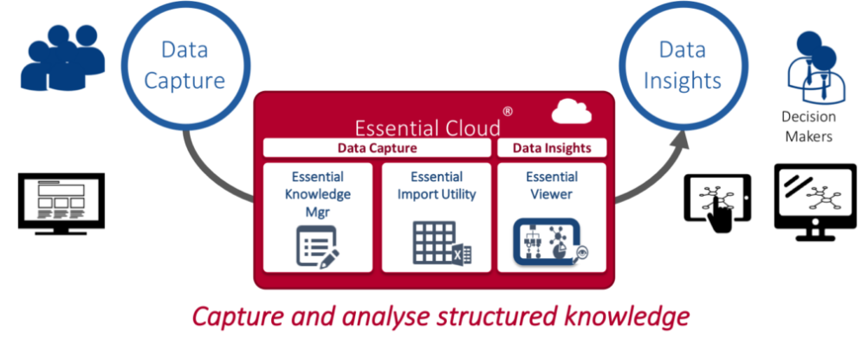
Essential EA Tool (Open-Source) Overview
003
https://enterprise-architecture.org/products/essential-open-source/essential-os-download/

Slide 5
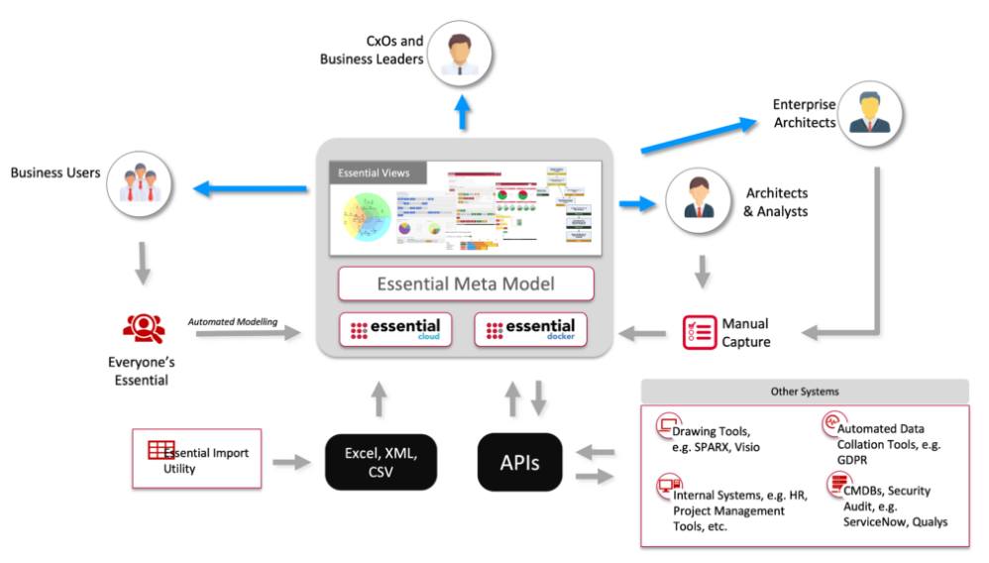
Essential Information Eco System

Slide 6
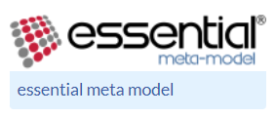
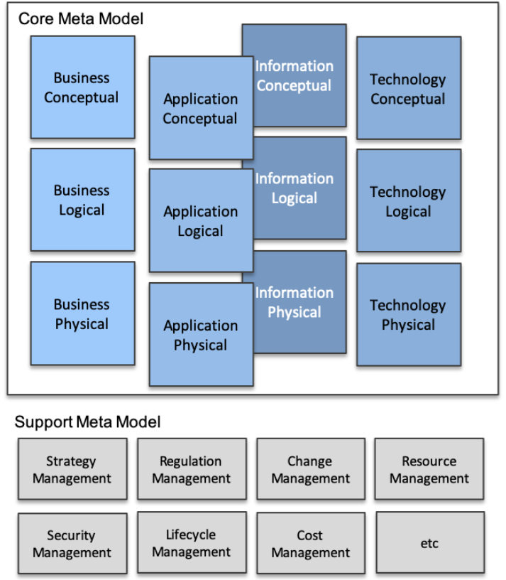
Essential Meta-Model
4 Layers
Business / Application / Information / Technology
3 Views
Conceptual / Logical / Physical
More Supporting areas

Slide 7
Essential Delivery Cycle
Identify stakeholders and concerns
Prioritize delivery
Identify/define the views that will support delivery
(Optional) Identify any meta-model extensions required and the impact on views
Identify the data required, data sources and population method
Plan Training / Consultancy
(Optional) Extend launchpad and build integrations and views as required
Complete Portal and Repository set-up
Capture Data
Embed EA data management process to ensure data is maintained
Measure value

Slide 8
Essential EA Tool – Starting from Business Capability Model
004
https://enterprise-architecture.org/products/essential-open-source/essential-os-download/

Slide 9
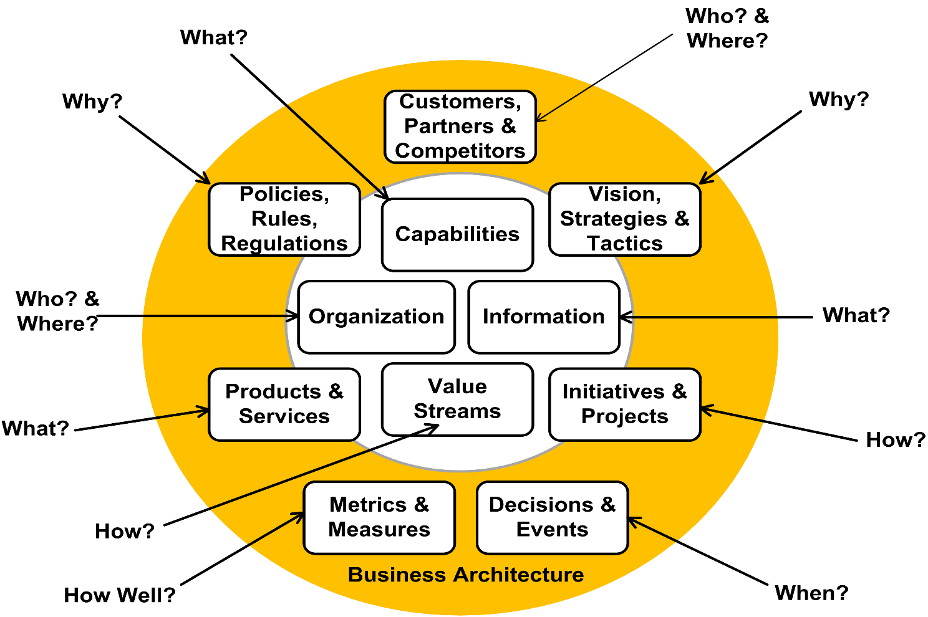
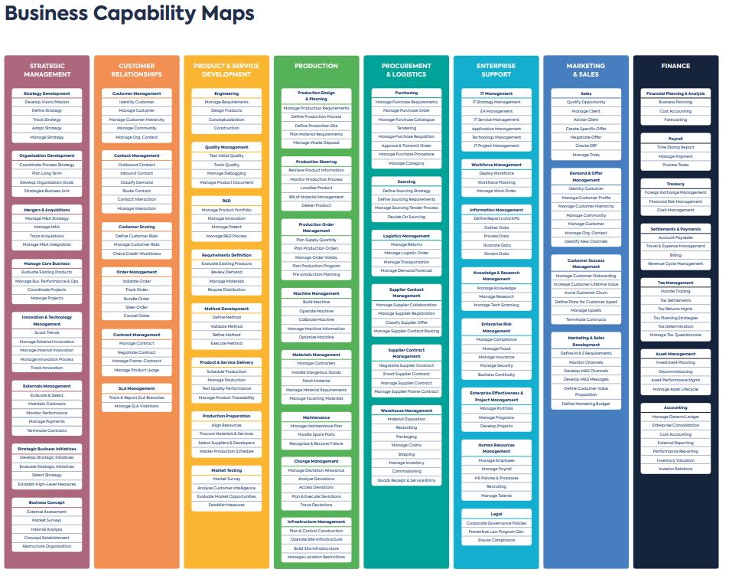
Domains in Business Architecture -- Starting from Defining Business Capability

